Slide 1
Asthma
BY
Carl Thomson
Notes:
Introductions
How is everyone?
Any questions before we get started?

Slide 2
OUTCOMES
By the end of the session you should be able to:
Define Asthma
Further understand the pathophysiology that causes Asthma
Know how to MANAGE Asthma
Further understand the Pharmacology of treatment for Asthma
Notes:
What we learn today we will take into the clinical labs and add to our patient assessment when dealing with heart failure in simulation

Slide 3
HOW WE ACHIEVE OUTCOMES
We are going to discuss Asthma in detail
Some V.L.E. techniques
Draw upon knowledge from A&P
Draw upon knowledge from Pharmacology

Slide 4
DEFINITION OF ASTHMA
A chronic lung disorder that is marked by recurring episodes of airway obstruction (Merriam-Webster 2016)
A chronic condition that can have acute episodes!!!!
Notes:
The standard definition as above.
Is asthma considered as COPD? = No COPD is an umbrella term used to diagnose people who have chronic bronchitis, emphysema, or a combination of both. People with the chronic bronchitis form of COPD find it hard to breathe because their airways become swollen and filled with mucus. The same changes occur in people with asthma, but they happen because of triggers, or factors in the environment that cause a reaction. The triggers could be cigarette smoke, pet dander, dust, or a variety of other things. People with COPD tend to have milder versions of symptoms like shortness of breath even without triggers present, but when they are exposed to triggers, their symptoms can become even wors

Slide 5
PREVIOUS EXPERIENCES IN THE PRACTICE SETTING
Group Discussion
Notes:
Who has witnessed or been involved with a asthma pt in the practice setting?
Tell me about the situation? How was this managed, what was good or what could have been done better

Slide 6
SIGNS & SYMPTOMS OF ASTHMA
Shortness of breath
Dyspnoea
Chest tightness / constriction
Chest pain
Coughing
Wheezing
Nasal Flaring
Intercostal recession
Tracheal tug

Slide 7
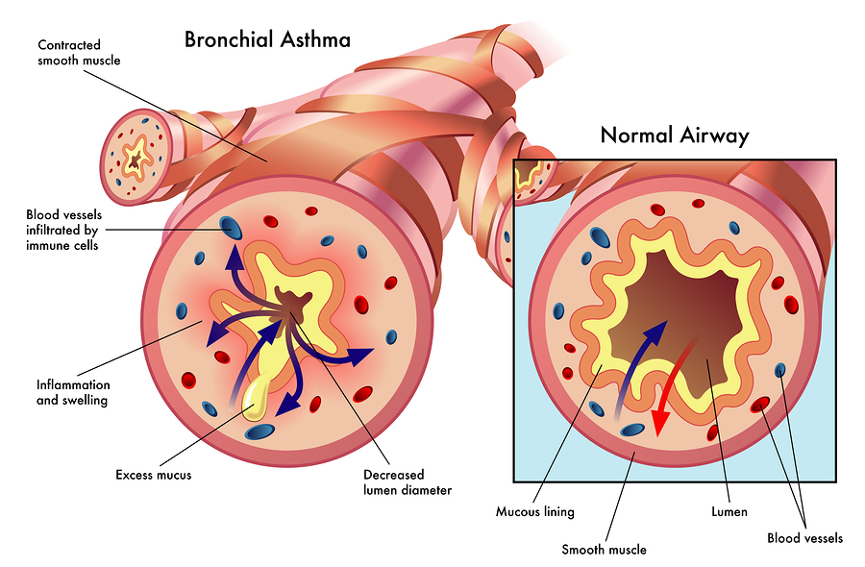
PATHOPHYSIOLOGY
https://www.youtube.com/watch?v=7EDo9pUYvPE = Animation
Notes:
Asthma can result in 2 ways: 1st Broncho spasm where inflammation of the smooth muscle causes a narrowing of the airway lumen
2nd excessive mucus also causing narrowing of the airway or a combination of the both…….

Slide 8
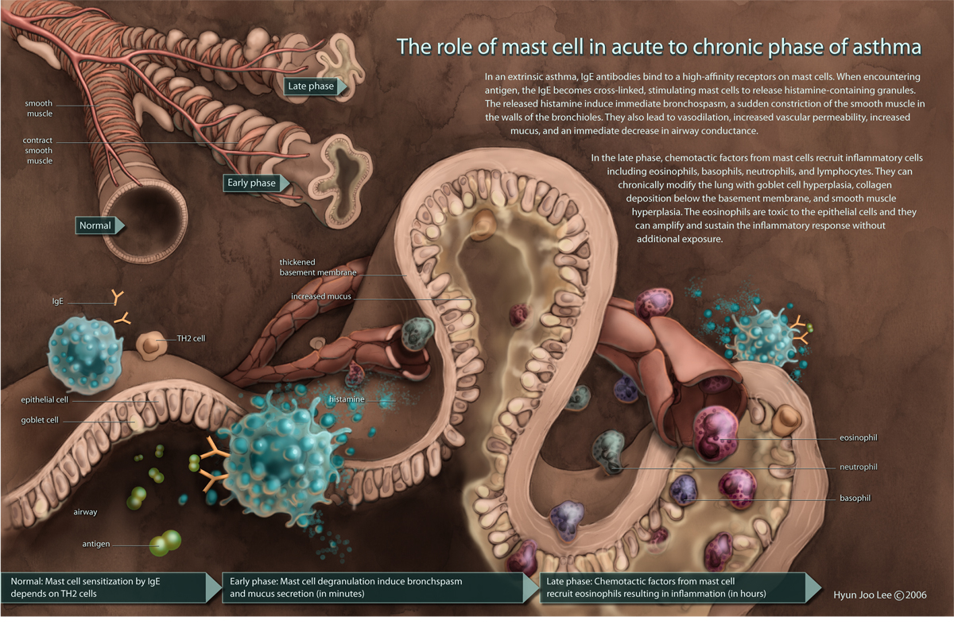
PATHOPHYSIOLOGY
Notes:
What Are Mast Cells?
Mast cells are "master regulators“ type of wbc of the immune system. They come from bone marrow and go into all tissues of the body. Each mast cell contains secretory granules (storage sacs), each containing powerful biologically active molecules called mediators (histamines, luekotrines, cytokines etc . These can be secreted when mast cells are triggered, leading to allergic and inflammatory diseases

Slide 9
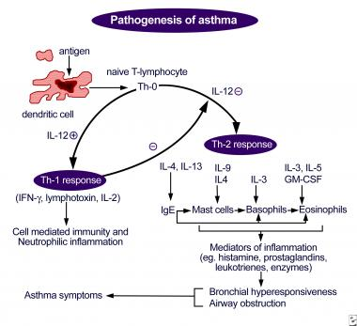
PATHOPHYSIOLOGY
Notes:
Macrophage (dendritic) cell engulfs the antigen (foreign body) – these are presented to t helper cells (lymphocytes b & t cells) once activated with IgE (immunoglobin, there are several types of immunoglobins but IgE are found in lungs, airways and mucus membranes) these have a high affinity / attraction to mast cells (master mediators) – it’s the mast cells that degranulate an release mediators such as histamines, luekotrienes etc which are responsible for the bronchial spasm / hyperesponseivness and excess mucus secretion. Basophils & eosnophils are another form of wbc.
Lymphotoxin = (previously known as tumor necrosis factor-beta) is a lymphokine cytokine. It is a protein that is produced by Th1 type T-cells and induces vascular endothelial cells to change their surface adhesion molecules to allow phagocytic cells to bind to them

