Slide 1
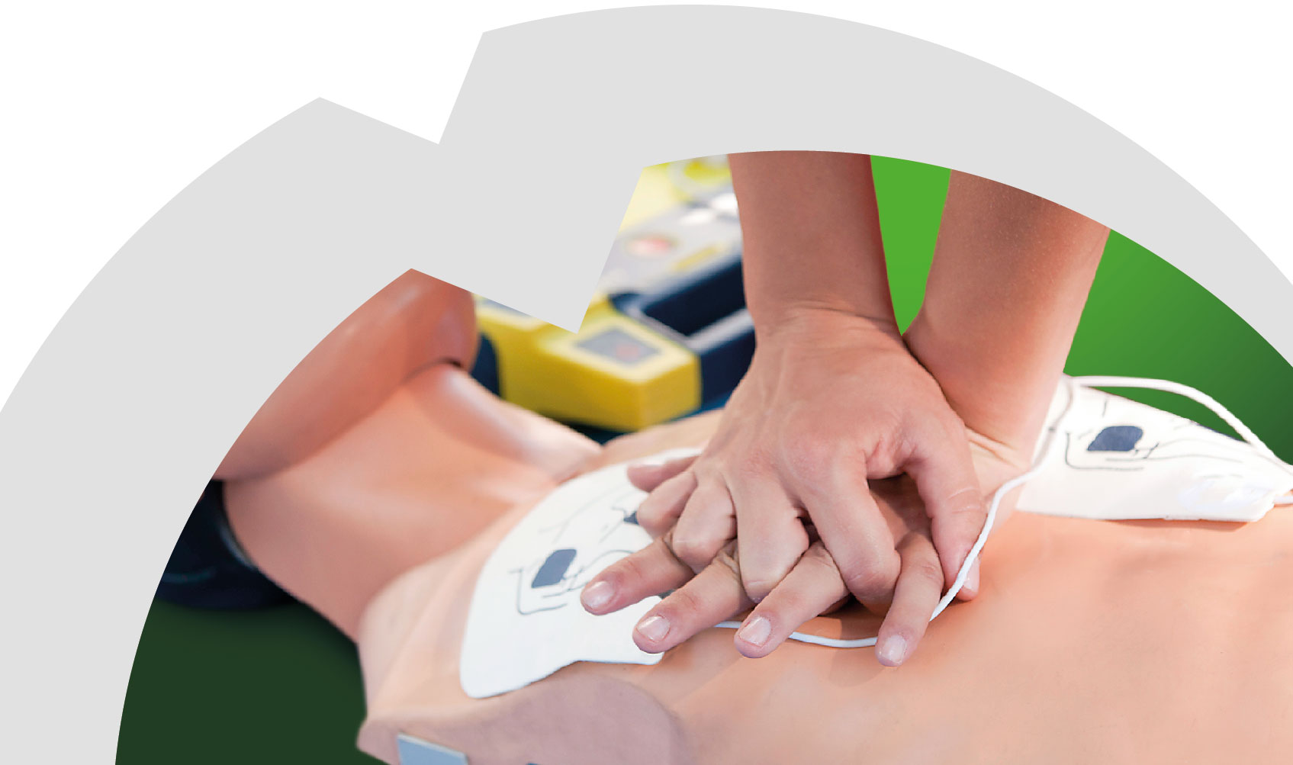
First Response Emergency Care
Welcome
Notes:
Hello & Welcome
introductions
House keeping
Ice breaker

Slide 2
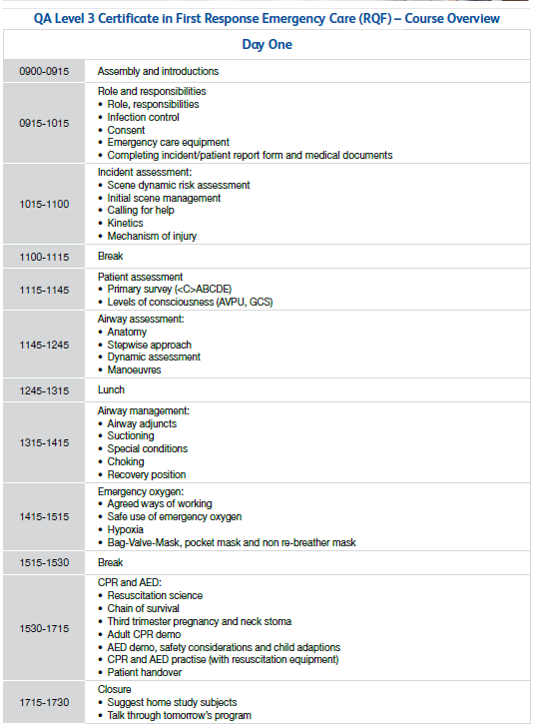
Day One

Slide 3
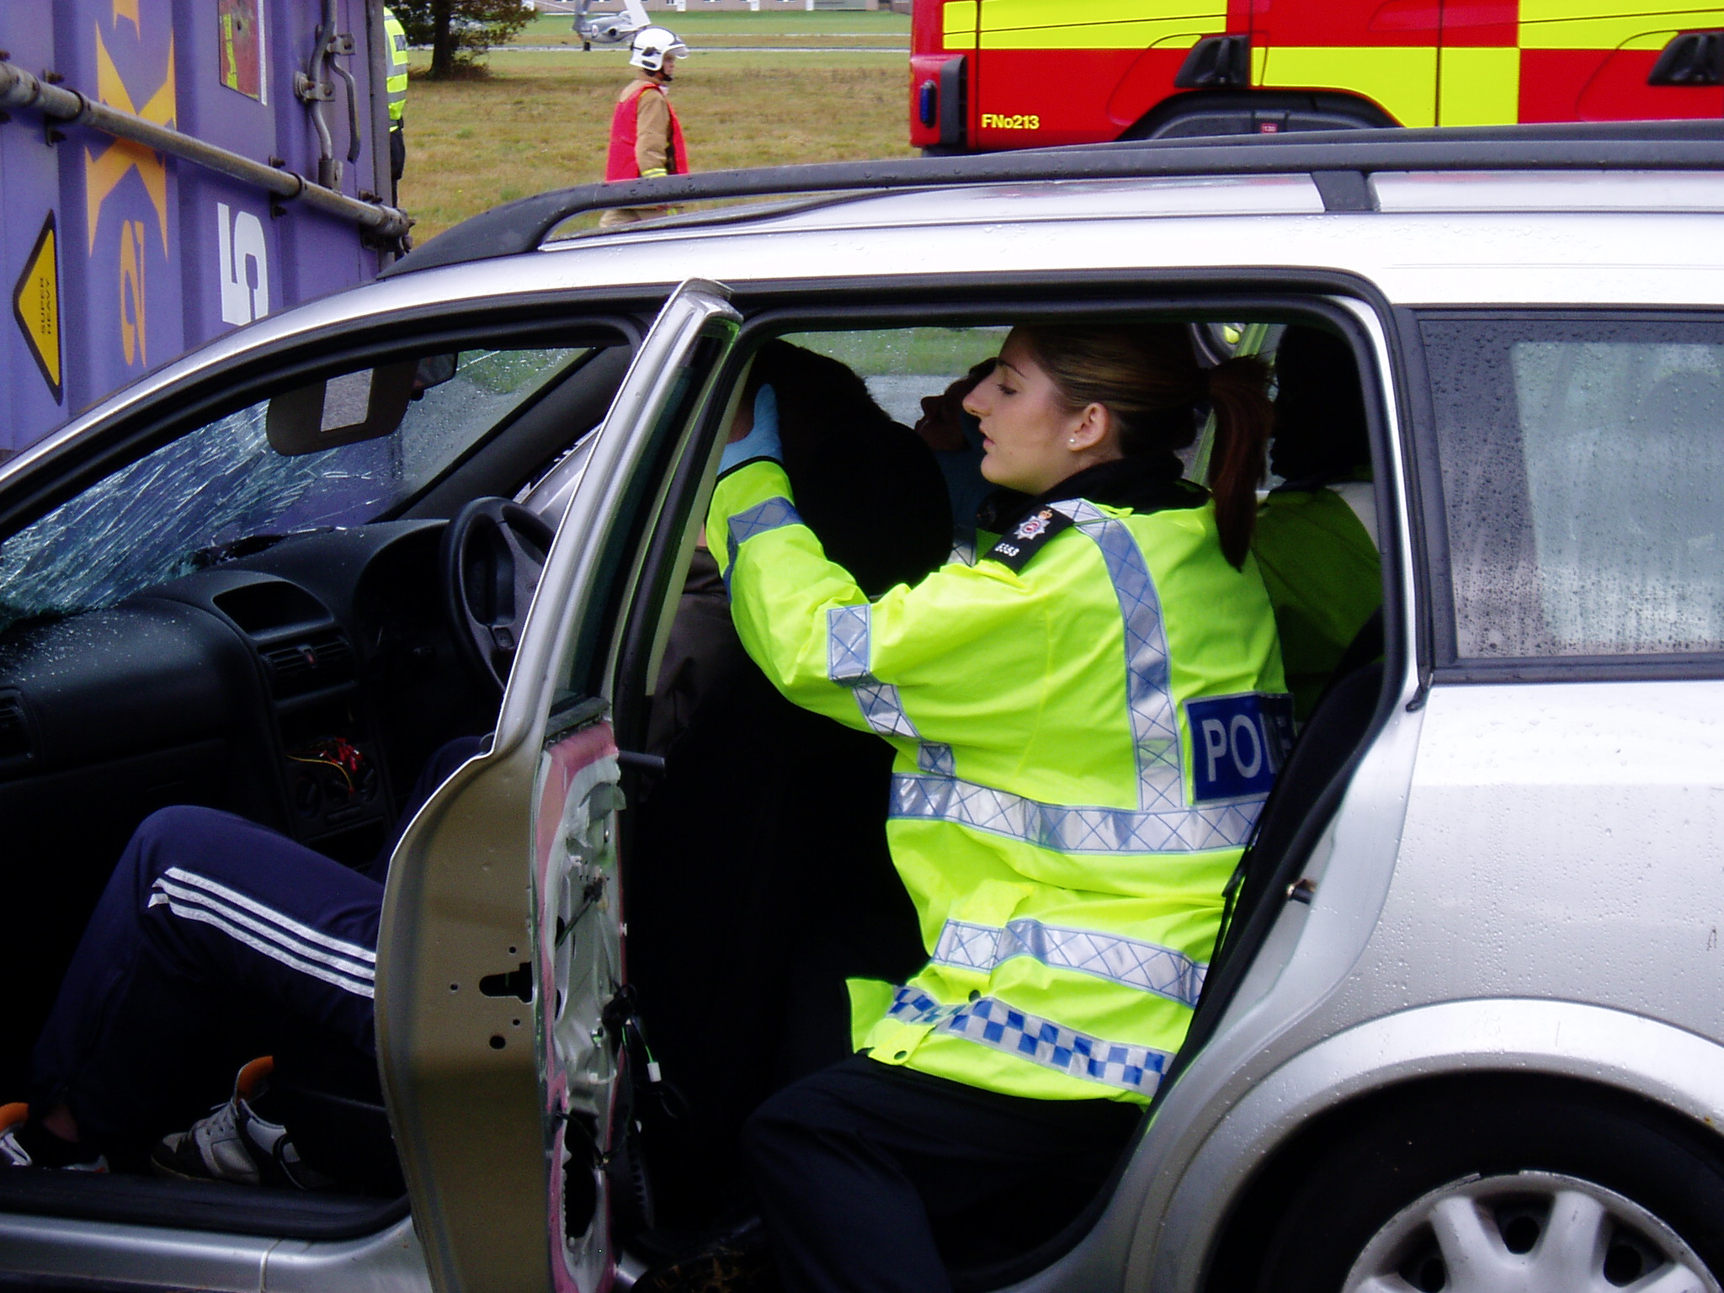
The role of the first responder
Assessing the situation
What happened Number of casualties History, signs, symptoms
Protecting from dangers
Assess for further danger Protect yourself first
Getting help
Ask bystanders Which emergency services? Recognise your limitations
Prioritising treatment
Most urgent thing first Most urgent person first Offer support and comfort
Minimising infection risks
Wash hands before and after giving help
Wear disposable gloves Wear protective clothing if needed Cover your own cuts with a plaster
Dispose of contaminated waste carefully Use sterile, undamaged, in-date dressings

Slide 4
Consent
Voluntary
Made without pressure or Influence
Informed
Treatment explained including benefits and risks and what could happen if they don’t.
Capacity
The patient must have the mental capacity to understand Information and decide.
Implied
Patient is incapacitated or unresponsive.
A conscious patient MUST give their permission
before they receive ANY type of medical attention.

Slide 5
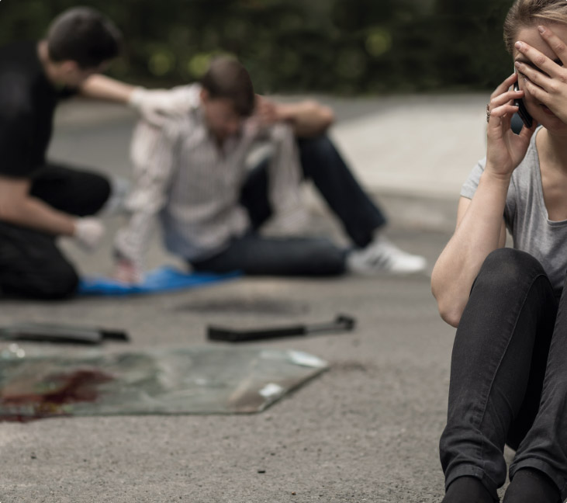
Scene survey & Initial scene management
DANGERS – safety to yourself & your colleague
What things should you consider before treating anyone?
What happened?
Further danger?
Can you cope?
Number of casualties?
Emergency services?
Who needs help first?

Slide 6
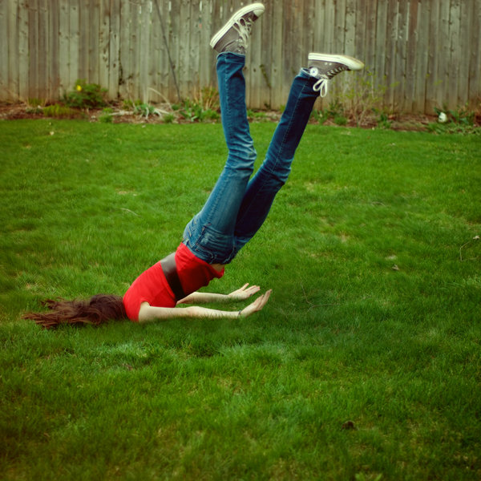
Kinetics
Injury prediction
Information drawn from the scene and the patient. Obtaining an complete history and accurate assessment can significantly improve a patients treatment plan and potential recovery.
Kinetics
Who hit what?
What speed?
Mechanisms involved?
Restraint or protection?
MORE SPEED = MORE DAMAGE
KE = 1/2 M V²
Kinetic Energy (KE) size of the individual, the speed of impact
Mass (M) body weight
Velocity (V) represents the speed of the body
Deceleration force
Notes:
150LB MAN ON BIKE AT 30MPH = (900 * 75) 67,500
160LB MAN ON BIKE AT 30MPH = (900 * 80) 72,000
150LB MAN ON BIKE AT 40MPH = (1600*75) 120,000

Slide 7
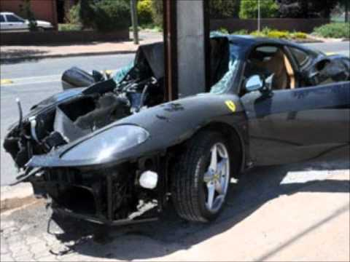
Mechanism of Injury
Mechanism of Injury
Traffic collisions
Frontal impact
Side impact
Deceleration injuries
Airbags
Secondary protection systems
Motor cycle collision
Pedestrian collisions
Falls
Falls from greater than twice the height of the individual have the potential to produce significant injuries.
Blast injuries
Primary injury – show wave damaging gas-containing organs and burns from being in close proximity to the blast.
Secondary injury – high speed objects causing injuries such as minor lacerations to severe crushing or death.
Tertiary injury - thrown as a result of the explosion and will be caused either by the patient hitting and object or landing upon.

Slide 8
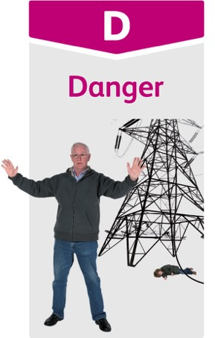
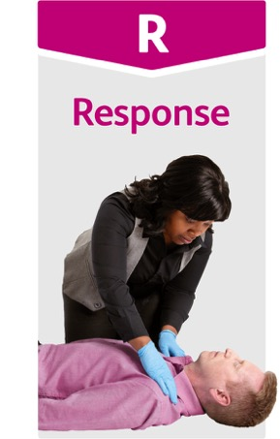
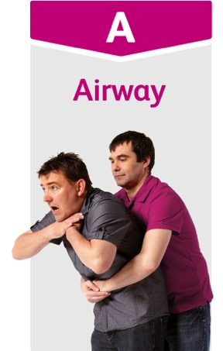
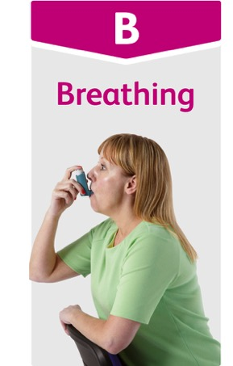
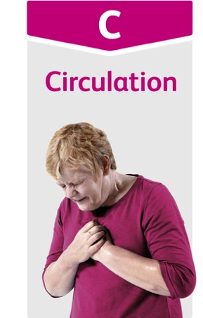
The primary survey
Treat life-threatening conditions as soon as you find them, before moving on
You might not get as far as C
“Catastrophic Bleeding” can be prioritised before “Airway”

Slide 9
Levels of response – AVPU in more detail
A
Alert
V
Confused
Voice
Inappropriate words
Utters sounds
No verbal response
P
Pain
Localises pain
Responds only
U
Unresponsive

Slide 10
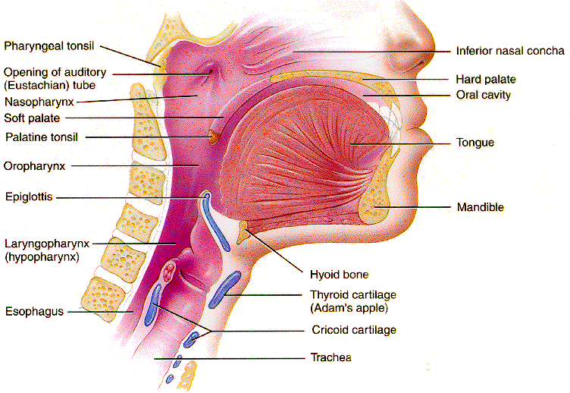
Airway anatomy
Nasal Cavity
Oral Cavity
Tongue
Epiglottis
Oesophagus
Trachea

Slide 11
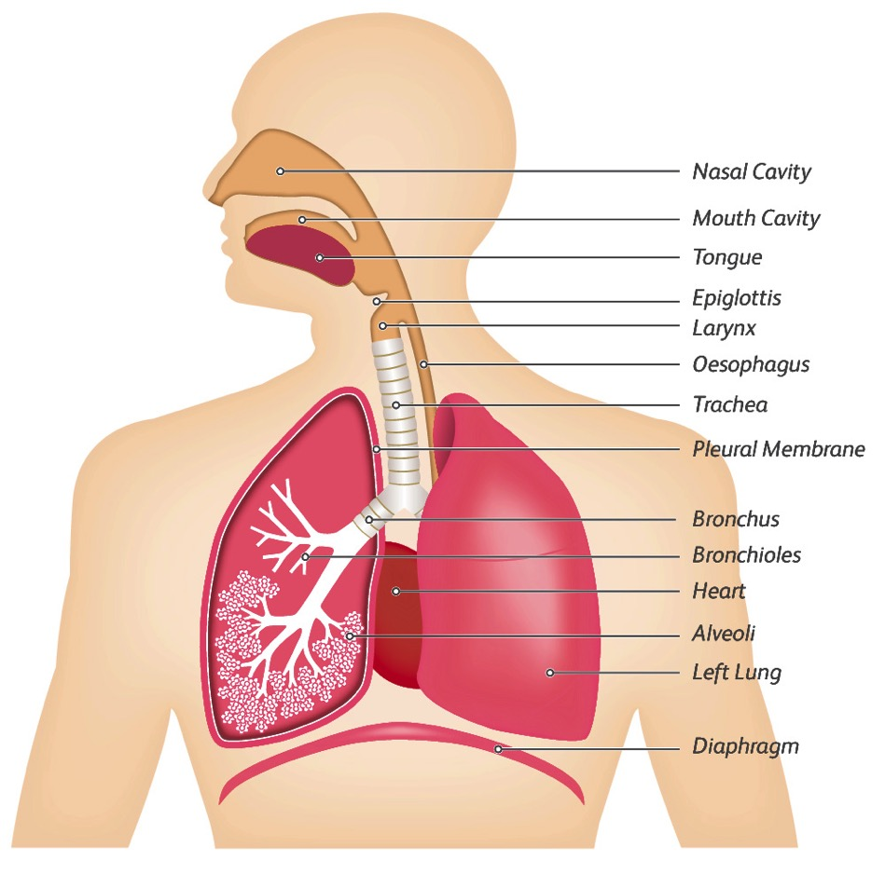
The respiratory system

Slide 12
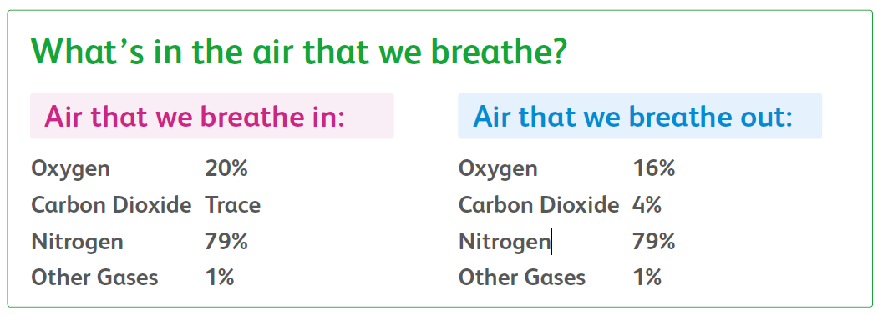
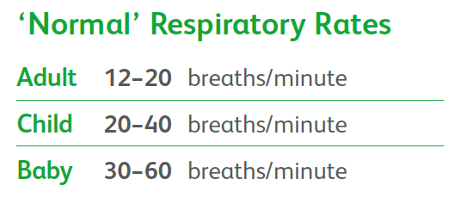
The respiratory system

